Slide 1
Python and SQLite
Gotchas and Gimmes
PyCon Presentation Apr 2016
Dave Sawyer
dsawyer@box.com

Slide 2
What is SQLite?
In-process SQL database engine
Free for any use
Compact (300K lib, 4K stack, 100K heap)
Fast (10,000+ statements / second)
Reliable (100% branch coverage, 787x test code)

Slide 3

Why use SQLite?
We have pickle. Isn’t that good enough?

Slide 4
Why use SQLite?
Handle large datasets
Sort/Search efficiently
Transactions with rollback
Safe format
32/64 big/little endian agnostic
Concurrency

Slide 5
Simple SQLite
# Copied directly from Python documentation on sqlite3 import sqlite3 connection = sqlite3.connect('example.db') c = connection.cursor() # Create table c.execute("CREATE TABLE stocks (symbol text, quantity real, price real)") # Insert a row of data c.execute("INSERT INTO stocks VALUES ('RHAT', 100, 35.14)") # Save (commit) the changes connection.commit() # We can close the connection if we are done with it. # Just be sure any changes have been committed or they will be lost
connection.close()

Slide 6
Simple?
# Copied directly from Python documentation on sqlite3 import sqlite3 connection = sqlite3.connect('example.db') c = connection.cursor() # Create table c.execute("CREATE TABLE stocks (symbol text, quantity real, price real)") # Insert a row of data c.execute("INSERT INTO stocks VALUES ('RHAT', 100, 35.14)") # Save (commit) the changes connection.commit() # We can close the connection if we are done with it.
# Just be sure any changes have been committed or they will be lost
connection.close()
Autocommit!
Connection.rollback()
Don’t forget?

Slide 7
Use Context Managers
import sqlite3 connection = sqlite3.connect('example.db') # Create table ## Use a transaction to commit or rollback a set of changes with connection: connection.execute("CREATE TABLE stocks (symbol text, quantity real, price real)") # Insert a row of data with connection: connection.execute("INSERT INTO stocks VALUES ('RHAT', 100, 35.14)") # We can close the connection if we are done with it. connection.close()
Context manager
Cursor “convenience”

Slide 8
Getting Real
def sql_value(value): """Convert a python value to something that can be stored in SQLite""“
# Note: Not needed if we update code to use DBAPI bindings. if isinstance(value, basestring): return "'" + value + "'" else: return unicode(value) class Stock(object): """Represents a stock holding (symbol, quantity, and price""" def __init__(self, symbol='', quantity=0, price=0.0): self.symbol = symbol self.quantity = quantity self.price = price @classmethod def from_row(cls, row): return Stock(*row)

Slide 9
Getting Real
class StockDB(object): def __init__(self): self._connection = sqlite3.connect('example.db')

Slide 10
Getting Real
class StockDB(object): def __init__(self): self._connection = sqlite3.connect('example.db')
def create_table(self): with closing(self._connection.cursor()) as cursor: cursor.execute("CREATE TABLE stocks (symbol text, quantity real, price real)")
closing()

Slide 11
Getting Real
class StockDB(object): def __init__(self): self._connection = sqlite3.connect('example.db') def create_table(self): with closing(self._connection.cursor()) as cursor: cursor.execute("CREATE TABLE stocks (symbol text, quantity real, price real)")
# Insert a row of data c.execute("INSERT INTO stocks VALUES ('RHAT', 100, 35.14)")
def insert(self, stock): keys = stock.__dict__.iterkeys() values = (sql_value(x) for x in stock.__dict__.itervalues()) with closing(self._connection.cursor()) as cursor: cursor.execute("INSERT INTO stocks({}) VALUES ({})".format(
", ".join(keys), ", ".join(values)))
Unsafe!

Slide 12
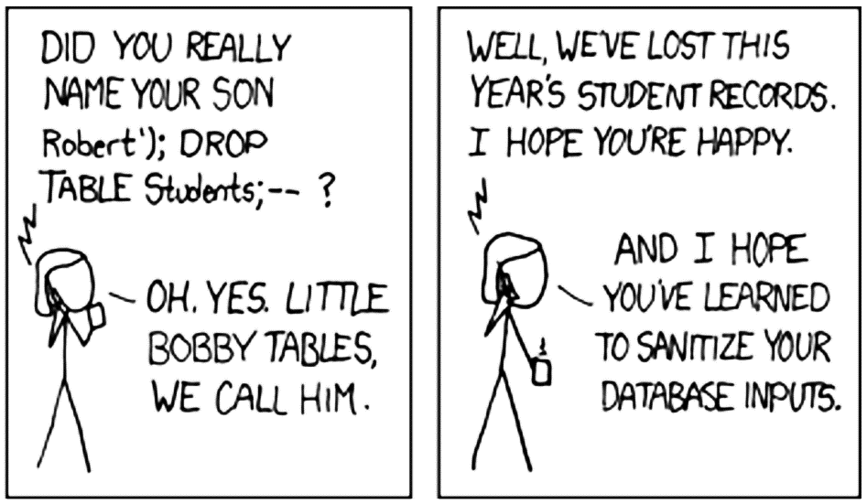
http://xkcd.com/327/

Slide 13
Example Code (take 3)
import sqlite3 connection = sqlite3.connect('example.db') # Create table ## Use a transaction to commit or rollback a set of changes with connection: connection.execute("CREATE TABLE stocks (symbol text, quantity real, price real)") # Insert a row of data with connection: connection.execute("INSERT INTO stocks VALUES (?,?,?)", ('RHAT', 100, 35.14)) # We can close the connection if we are done with it. connection.close()

Slide 14
Getting Real
class StockDB(object): def __init__(self): self._connection = sqlite3.connect('example.db') def create_table(self): with closing(self._connection.cursor()) as cursor: cursor.execute("CREATE TABLE stocks (symbol text, quantity real, price real)")
def insert(self, stock): places = ','.join(['?'] * len(stock.__dict__)) keys = ','.join(stock.__dict__.iterkeys()) values = tuple(stock.__dict__.itervalues()) with closing(self._connection.cursor()) as cursor: cursor.execute("INSERT INTO stocks({}) VALUES ({})".format(
keys, places), values)

Slide 15
Getting Real
class StockDB(object): def __init__(self): self._connection = sqlite3.connect('example.db') def create_table(self): with closing(self._connection.cursor()) as cursor: cursor.execute("CREATE TABLE stocks (symbol text, quantity real, price real)")
def insert(self, stock): places = ','.join(['?'] * len(stock.__dict__)) keys = ','.join(stock.__dict__.iterkeys()) values = tuple(stock.__dict__.itervalues()) with closing(self._connection.cursor()) as cursor: cursor.execute("INSERT INTO stocks({}) VALUES ({})".format(keys, places), values)
def lookup(self, symbol): with closing(self._connection.cursor()) as cursor: cursor.execute("SELECT * FROM stocks WHERE symbol= ?", (symbol,)) row = cursor.fetchone() return Stock.from_row(row) if row else None

Slide 16
Getting Real
class StockDB(object): def __init__(self): self._connection = sqlite3.connect('example.db') def create_table(self): with closing(self._connection.cursor()) as cursor: cursor.execute("CREATE TABLE stocks (symbol text, quantity real, price real)") def lookup(self, symbol): with closing(self._connection.cursor()) as cursor: cursor.execute('SELECT * FROM stocks WHERE symbol = ?', (symbol,)) row = cursor.fetchone() return Stock.from_row(row) if row else None
def insert(self, stock): places = ','.join(['?'] * len(stock.__dict__)) keys = ','.join(stock.__dict__.iterkeys()) values = tuple(stock.__dict__.itervalues()) with closing(self._connection.cursor()) as cursor: cursor.execute("INSERT INTO stocks({}) VALUES ({})".format(keys, places), values)
def update(self, stock): updates = ','.join(key + ' = ?' for key in stock.__dict__.iterkeys()) values = tuple(stock.__dict__.values() + [stock.symbol]) with closing(self._connection.cursor()) as cursor: cursor.execute('UPDATE stocks SET {} WHERE symbol = ?'.format(updates), values)
def transaction(self): return self._connection

Slide 17
SQLite Isolation Levels
Deferred
Immediate
Exclusive
Reading
Allowed
Reading
Allowed
No other
writers
Reading
and
Writing
(Exclusive)
One writer
at a time
One writer

Slide 18
SQLite Isolation Levels - Locks
Deferred
Immediate
Exclusive
Shared Lock
reading
Reserved Lock
Only 1 of these.
Shared still ok.
Setup journal.
Reading
(Shared)
Reading
(Reserved)
Reading
and
Writing
(Exclusive)
Pending Lock
No more shared
locks given out.
Draining reads.
Write Start
(Reserved)
Write Start
(Reserved)
Writing wait
(Pending)
Writing wait
(Pending)
Exclusive Lock
No locks of any kind given out.
Writing
(Exclusive)
Writing
(Exclusive)

Slide 19
Getting Concurrent
class StockDB(object): def __init__(self): ## 1. ADD check_same_thread ## This allows us to use multiple threads on the same connection.
## Requires SQLite 3.3.1 (Jan 2006) or later ## 2. Change the isolation level to deferred so we can control transactions self._connection = sqlite3.connect('example.db', check_same_thread=False, isolation_level='DEFERRED')
## 3. Use WAL mode. Requires SQLite 3.7.0 (Jul 2010) self._connection.execute('PRAGMA journal_mode = WAL')

Slide 20
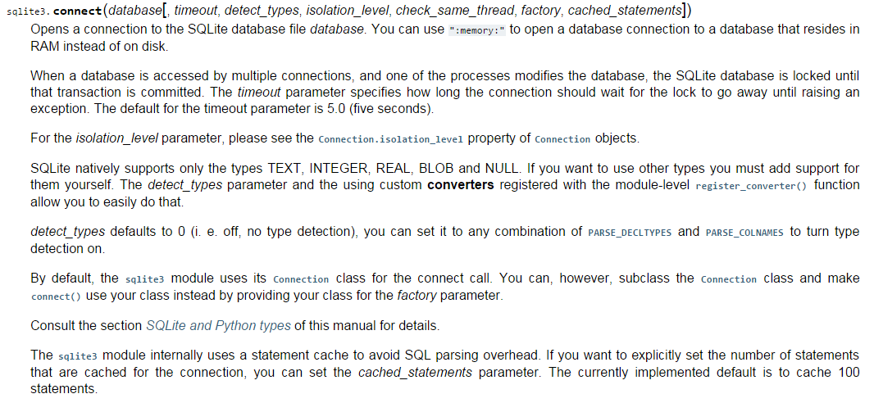

Slide 21
Getting Concurrent
class StockDB(object): def __init__(self): ## 1. ADD check_same_thread ## This allows us to use multiple threads on the same connection.
## Requires SQLite 3.3.1 (Jan 2006) or later ## 2. Change the isolation level to deferred so we can control transactions self._connection = sqlite3.connect('example.db', check_same_thread=False, isolation_level='DEFERRED')
## 3. Use WAL mode. Requires SQLite 3.7.0 (Jul 2010) self._connection.execute('PRAGMA journal_mode = WAL')
WAL mode!

Slide 22
What is WAL mode?
Write-Ahead Logging
Readers
Readers
Readers
Writer
Writer
Writer
This lets us read at the same time we write

Slide 23
How Do I Get This?
sqlite3.version
Module version. “This is not the version of the SQLite library”
sqlite3.sqlite_version
Platform | Version
Windows, Python 2.7.x | 3.6.21
Windows, Python 3.4.x | 3.8.3.1
Windows, Python 3.5.1 | 3.8.11
OSX 10.11 | 3.8.10.2
OSX 10.10 | 3.8.5
OSX 10.9 | 3.7.13
OSX 10.8 | 3.6.18
Linux | Check manually
To upgrade, just drop in new version of SQLite (sqlite.dll or /usr/bin/sqlite3)

Slide 24
Next Steps?
Only one set of changes per connection
Create a connection per thread
@property
def connection(self):
tlocal = threading.local()
db_connection = getattr(tlocal, ‘db_conn', None) if db_connection is None: db_connection = self._sqlite_connect() tlocal.db_conn = db_connection
Use a lock when writing
@contextmanager def transaction(self): with self._lock: try: yield self._connection.commit() except: self._connection.rollback() raise
Both work!

Slide 25
Thank You!
Complete code available on github.com/kingsawyer
References: https://docs.python.org/2/library/sqlite3.html
https://www.sqlite.org/lockingv3.html

